Slide 1
MobileLink
Take your business to new places

Slide 2
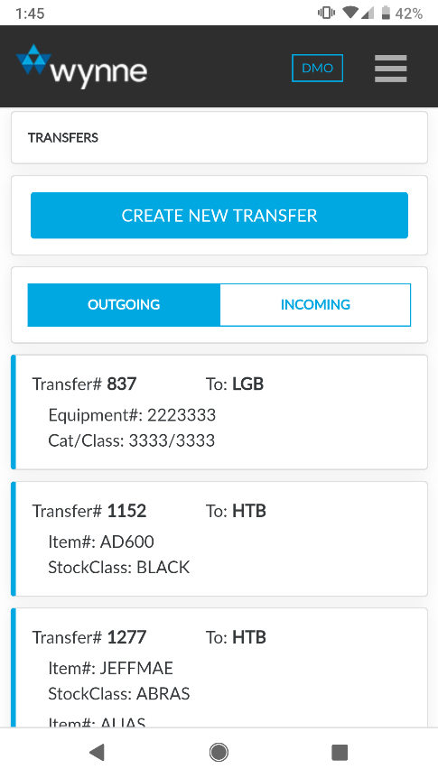
Accelerate your operations
Empower field and yard teams with anytime, anywhere access to RentalMan. MobileLink enables rental companies to provide a more streamlined customer experience and automate error-prone manual processes.
What's more, unique features only possible with a mobile application increase damage revenue, shorten DSO (days sales outstanding), and provide all-encompassing fleet visibility.

Slide 3
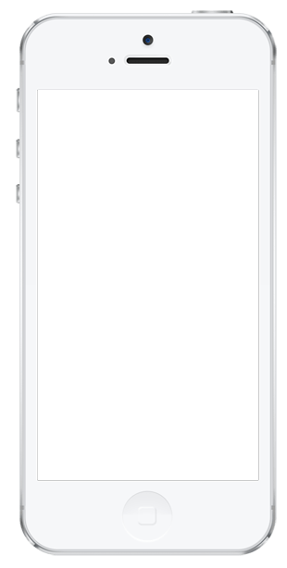
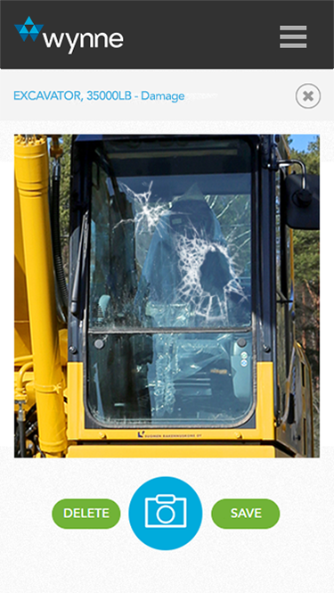
Reduce Disputes
Eliminate disputes and receive payment on customer damage invoices faster by providing photographic evidence. This retains the relationship with your customer while minimizing administrative costs chasing bad debt.

Slide 4
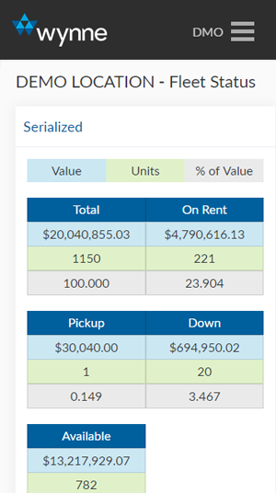
Fleet Visibility
Real-time data of your fleet’s status gives your branch managers and sales teams insight on performance and availability.

Slide 5
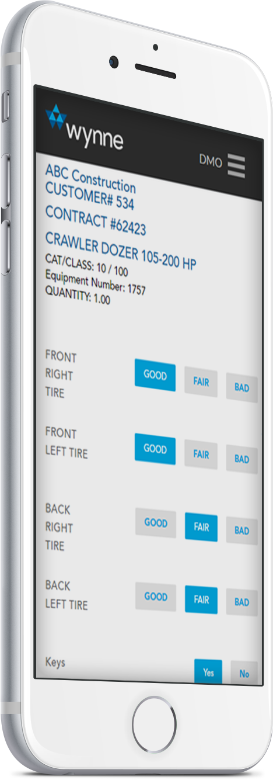
Accelerated Operations
Check out and check in
Accept and dispatch transfers
Capture equipment condition
Simplified condition reports

Slide 6
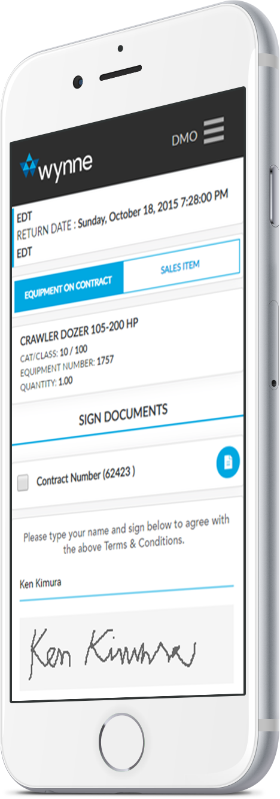
Signature capture
Capture signatures for one or all unsigned contracts
Quick pick
MobileLink will display upcoming reservations so users know which equipment to check out first, reducing late deliveries
Wear equipment fleet evenly
The app will suggest which unit to check out based on the last time it was rented, allowing you to wear your fleet more evenly
Held returns
Check in equipment to keep their status accurate, while the contract remains open for billing and administrative purposes

Slide 7
MobileLink
Take your business to new places
2601 Main St, Suite 270
Irvine, CA 92614 U.S.A.
949 224 6300, ext. 2
marketing@wynnesystems.com

